Slide 1
CLOUD PROJECT
Team Name: CloudFanic
TEAM MEMBERS:
ROSHAN G - 312422106134 ECE SJIT
KABILESHKUMAR R - 312322205075 IT SJCE
PROBLEM Statement title: A mindfull companion :digital support for memory loss

Slide 2
INTRODUCTION AND ABSTRACT
INTRODUCTION:
Amnesia & Disorientation: A Safety Gap
People with amnesia can become disoriented and forget their surroundings, creating safety risks. Traditional methods like constant caregiver supervision or bulky tracking devices are inconvenient and ineffective
ABSTRACT:
We're developing a simulation tracker for people with amnesia. This innovative solution leverages cutting-edge technology (powered by AWS) to provide real-time location tracking. Imagine a small, comfortable device that sends instant alerts to designated caregivers whenever the wearer wanders outside of pre-defined safe zones. This not only enhances safety for individuals with amnesia but also offers peace of mind and reduced burden for their caregivers.

Slide 3
Proposed solution
Many with amnesia experience disorientation and wandering, creating a constant worry for caregivers. Our solution tackles this challenge By leveraging the AWS IoT Device Simulator, caregivers can gain valuable insights into the potential of our wearable tracker solution without the need for physical devices. This allows for efficient development, testing, and refinement before a full-fledged product launch.
Here's the ingenious part: caregivers can define personalized "safe zones" around familiar areas like home or parks using Amazon Location Services. If the wearer wanders outside these zones, an immediate alert with their last known location is sent to designated caregivers via SMS or app (powered by Amazon SNS).
This innovative system offers a safety net for both individuals with amnesia and their caregivers. Faster response times during wandering episodes bring peace of mind. Automated alerts free up caregivers, allowing for quality time and support. Defined safe zones provide a sense of independence within boundaries. This discreet tracking system empowers a better quality of life for all involved

Slide 4
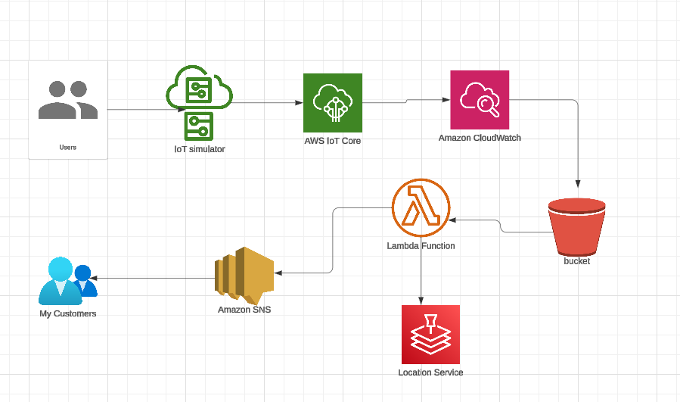
Architecture DIAGRAM AND TECH STACK
AWS IoT Core (MQTT protocol)
AWS Lambda ( Node.js)
Amazon SNS (Topics, Subscriptions, AWS SDK)
Amazon Location Service (Maps, Geocoding, Routing, Tracking APIs, AWS SDK)
Simulated IoT Device (MQTT client library, location data simulation)
Subscribers (Email, SMS, Mobile Push Notifications)
Monitoring and Logging (CloudWatch)

Slide 5
USE CASES:
DEPENDENCIES:
.
Wander Outside Safe Zone: The amnesia patient, wearing the discreet wearable tracker, may inadvertently wander outside the defined safe zones due to their condition.
Transmit Location: The wearable tracker continuously transmits the patient's real-time location data securely to the cloud platform.
Detect Safe Zone Breach: The cloud platform monitors the patient's location and detects if they have breached the safe zone boundaries.
Send Alerts: If a safe zone breach is detected, the cloud platform immediately sends an alert with the patient's last known location to designated caregivers via SMS or a mobile app.
Receive Alerts: The caregivers receive the alerts, allowing them to take prompt action and locate the patient quickly during wandering episodes.
AWS IoT Core: Securely connects the wearable tracker to the cloud and manages data streams.
Amazon Location Service: Defines and manages geofences (safe zones) and triggers alerts when breached.
AWS Lambda Function (Optional): Processes location data before sending it to Amazon Location Service (e.g., data filtering or enrichment).
Amazon SNS: Sends notification messages (SMS or app push notifications) to caregivers when a geofence is breached.

Slide 6
FUTURE WORK AND CONCLUSION
FUTURE WORK
Real-Time Data Integration: Move beyond simulated data by integrating the simulator with real-time location tracking services (with user consent) to test the system with actual user movement patterns
Mobile App Integration: Develop a mobile application for caregivers that seamlessly integrates with the cloud platform, allowing them to receive alerts, view location data, and manage settings on the go.
Data Visualization Tools: Implement data visualization tools within the cloud platform to provide caregivers with intuitive dashboards that display location history, trends in vital signs (if simulated), and other relevant data
CONCLUSION
In conclusion, this iot simulator and caregiver alert system, powered by AWS, offers a promising solution for managing wandering in individuals with amnesia. By providing real-time location tracking, automated alerts, and safe zone functionality, the system enhances safety, fosters independence, and reduces anxiety for both the wearer and their caregivers. This innovative solution has the potential to significantly improve the quality of life for all involved.

